Slide 1

Query-guided Multi-perspective Answer Summarization
Abhinav Anand
Vivek Mathur
Kunal kamalkishore

Slide 2
Contents
Introduction
Dataset – Answersumm
Related Research Papers
Suggested Approaches
Experiments and Results
Conclusion and Future work
Baselines Used

Slide 3
Introduction
Problem Statement
Prior Solution
Generate an abstractive summary to provide a single comprehensive answer given multiple possible answers to a question on a community question-answering forum
Use the question as a guide for summarization
Use the perspective from each of the multiple available answers to produce a single summarized answer
Most Community Question Answer forums have ‘best answer’ chosen manually
Drawbacks
Best answer gives one person perspective and maynot be relevant to the given query
Information from other users is lost as they are discarded
Summarization
Query Guided
Community Question Answering
Multi-perspective
Transform long text documents to short
Focus on useful information
No loss of meaning
Generation of document Summary based on a given Query
Discards the information that is not relevant to the Query
Community forums like Stakoverflow where users post their questions
Answers provided by multiple other users
Useful information available in multiple answers
Different users answers in their viewpoint/perspective

Slide 4
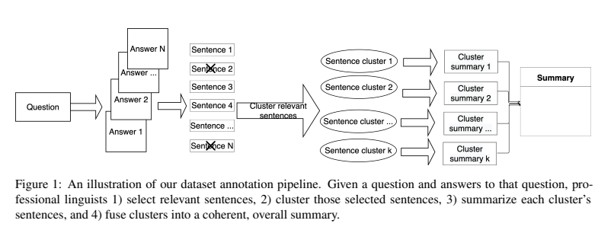
Dataset - Answersumm
For this project, we are using Answersumm dataset to train with multiple answers for a query
AnswerSumm : is a English-language dataset of questions and answers collected from a StackExchange data dump.The dataset was created to support the task of query-focused answer summarization with an emphasis on multi-perspective answers
Answersumm research paper:
https://aclanthology.org/2022.naacl-main.180.pdf
Answersumm
4,631 CQA threads used
8700 Summaries
Manually curated Dataset
Curated by Professional Linguists
Different perspectives captured
Annotations for
Relevant Answer
Group sentence by perspective
Summarize perspective
Produce overall summary
Annotation pipeline taken from the above research paper

Slide 5
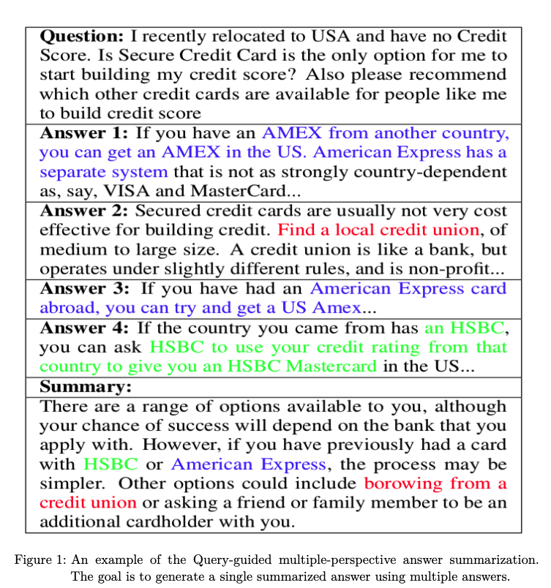
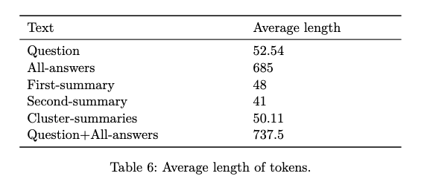
Overview of Answersumm dataset

Slide 6
Suggested Approaches
Various approaches for the query focused summarization are discussed in the paper “Exploring Neural Models for Query-Focused Summarization, Findings of NAACL 2022”. The options provided do not cover multi-perspective
Concatenates query and source passage as input, used for scoring
Two Step Approaches
End to End Approaches
Single-Encoder/Cross-Encoder
MARGE – Masked ROUGE extractor model is trained to predict relevance of source passages with respect to query
Dual-Encoder Models
DPR – Dual encoder model that encodes source and query separately
RELREG - Relevance Regression model is trained similar to MARGE
RELREGTT (Relevance Regression Two Tower) – Is a computationally efficient version of RELREG that uses dual-encoder architecture
Relevance=> ROUGE overlap between passage and summary
Certain query words are masked
No masking done for the query
ROUGE score is used to decide positive and negative relevance
BM25
BM25 is bag-of-words retrieval function that ranks set of documents based on query terms appearing in the document regardless of the proximity
BART
Encoder Decoder transformer model
LED (Longformer Encoder Decoder)
Encoder has full self attention
Addresses the BART input size limitation
SEGENC (Segment Encoder)
Pretrained for denoising objective
Bi-directional encode and autoregressive decoder
Combines local attention with sparse global attention
Splits the source document into overlapping segments
Uses windowed local attention
Each segment separately appended to the query and encoded
Input token size is greater than 16k
Separately encodes a query and source passage before calculating the cosine similarity
All two-step approaches share the same abstractor, a BART-large model

Slide 7
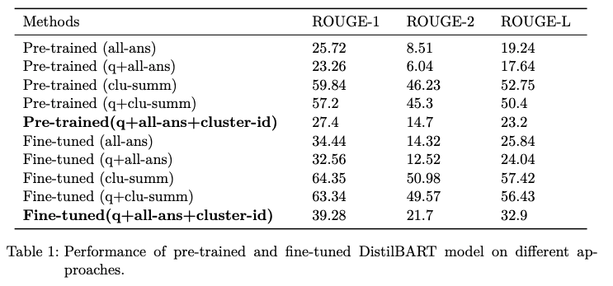
Baseline -1
Distilled BART model pretrained on XSUM dataset
Answersumm dataset with all answers concatenated for a question
Evaluate the Answersumm data on Distilled BART model
Fine-tune the model with Answersumm data
Evaluate the fine-tuned model with Answersumm data
Results
Baseline Testing pipeline – Model : DistilledBART, Dataset:XSUM
Results

Slide 8
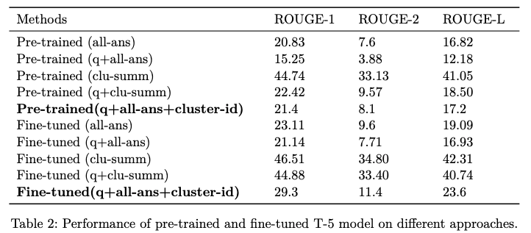
Baseline - 2
T5-small model
Answersumm dataset with all answers concatenated for a question
Evaluate the Answersumm data on T5-small model
Fine-tune the model with Answersumm data
Evaluate the fine-tuned model with Answersumm data
Results
Baseline Testing pipeline – Model : T5-small
Results

Slide 9
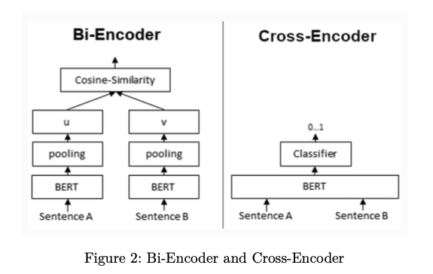
Two Step Approach
The suggested approaches will not work for multi-perspective scenarios. So, the approaches discussed in the prior slide needs to be modified to enable for multi-perspective query based summarization
Approach Used for this project
Extractor : Calculate the relevance of different sentences in all the answers against the query and score
Relevance with Rank-BM25
Multiple answers are ranked for the query relevance and top N answers are filtered
Relevance using Single Encoder / Cross-Encoder
Relevance is computed as the ROUGE overlap between the source passage and summary.
Filtered answers are concatenated and summarized using BART model
Relevance with Dual-Encoder
Encodes the query and source passage separately.
Cosine similarity gives the relevance score.
It provides computational benefits as passage embeddings can be precomputed and stored , reused for multiple queries.
Abstractor : Concatenate different answers selected from scoring and summarize using BART

Slide 10
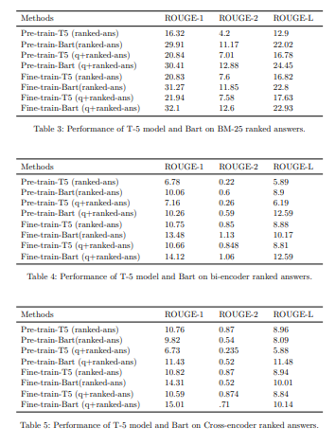
Results of two step approach

Slide 11
Conclusion and Future work
Conclusion
We have tried to address the problem of query guided multi-perspective summarization.
We used BART and T5 model as our summarizer. We observe that Bart pre-trained on summarization task outperforms T5 model especially when the task is similar to pre-traing task.
We also observe that simply taking the top ranked answers as source doesn’t helps in multi-perspective answer summarization as the top ranked answers fails to capture all the perspective.
Future Work
More experiments needs to be conducted to identify the best approach for multi-perspective query based summarization
The given answers may not be all correct. Future work can look at options of keeping only correct answers for summarization

Slide 12
Related Research Papers
Below are the papers referred for this project
AnswerSumm: A Manually-Curated Dataset and Pipeline for Answer Summarization, NAACL 2022
Exploring Neural Models for Query-Focused Summarization, Findings of NAACL 2022
Multi-Perspective Abstractive Answer Summarization
https://arxiv.org/pdf/2104.08536v1.pdf

